Slide 1
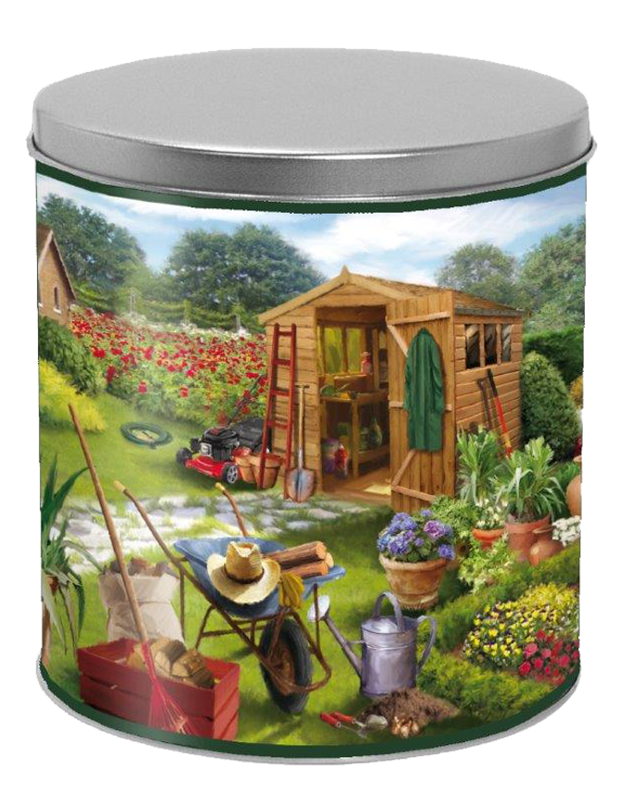
2 Tins of Cinnamon Crunch
2 Tins of Cinnamon Crunch
2 Tins of Cinnamon Crunch
2 Tins of Cinnamon Crunch
2 Tins of Cinnamon Crunch
2 Tins of Cinnamon Crunch
2 Tins of Cinnamon Crunch
2 Tins of Cinnamon Crunch
2 Tins of Cinnamon Crunch
2 Tins of Cinnamon Crunch
2 Tins of Cinnamon Crunch
2 Tins of Cinnamon Crunch
2 Tins of Cinnamon Crunch
2 Tins of Cinnamon Crunch
2 Tins of Cinnamon Crunch
2 Tins of Cinnamon Crunch
2 Tins of Cinnamon Crunch
2 Tins of Cinnamon Crunch
2 Tins of Cinnamon Crunch
2 Tins of Cinnamon Crunch
2 Tins of Cinnamon Crunch
2 Tins of Cinnamon Crunch
2 Tins of Cinnamon Crunch
2 Tins of Cinnamon Crunch

