Slide 1


Minsi Trails Council
REGISTER NOW
2024 Unit Leader Training

Slide 2

Powered by Popcorn
Scout Fundraising
Benefits for Scouts
Personal growth program that can be applied to advancement opportunities and service projects.
Earn Amazon eGift Cards
Millions of prize choices
Scouts choose the prizes they want
Scouts Learn
How to help others around them
Public speaking & math skills
Salesmanship & perseverance
How to earn their own way
The value of hard work
How to handle rejection

Slide 3
2023 Top Sellers
Scout Fundraising
Rank | Scout | Unit | District | Total Sales $
1 | Patrick L. | T191 | Lehigh | $7,615.00
2 | Jacob H. | P54 | Warren | $3,115.00
3 | Lucas D | P364 | Lehigh | $2,190.00
4 | Seth M. | T318 | Lehigh | $2,180.00
5 | Bryce G. | T89 | Monroe | $2,155.00
6 | Emmanuel M. | T318 | Lehigh | $2,094.00
7 | Cameron H. | T102 | Monroe | $1,966.00
8 | Matthew R. | T51 | Warren | $1,920.00
9 | Cora T. | T519 | Lehigh | $1,877.78
10 | Ethan G. | T80 | Monroe | $1,783.68
Rank | Unit | District | Total Sales $
1 | T40 | Northampton | $25,135.00
2 | P352 | Lehigh | $11,780.00
3 | P54 | Warren | $11,250.00
4 | P431 | Lehigh | $10,215.00
5 | T191 | Lehigh | $9,010.00
6 | P368 | Northampton | $8,982.00
7 | T519 | Lehigh | $8,265.00
8 | P364 | Lehigh | $8,235.00
9 | T317 | Northampton | $7,745.00
10 | T318 | Lehigh | $6,910.00

Slide 4

prepare
pre·​pare
prepared; preparing
transitive verb
to make ready beforehand for some purpose, use, or activity

Slide 5

Ideal Year of Scouting
Scout Fundraising
Plan Program
List activities & adventures
Hold a brainstorming session with families
Incorporate new adventures & activities.
Budget
Assign costs to activities and expenses.
Add in camp, registration fees, advancements & Unit dues.
Calendar
Provide a monthly calendar of activities so families are aware of the fun.
Set Goals
Calculate Unit goal: divide budget by expected popcorn commissions.
Divide Unit goal by # of Scouts to get Scout goals
Raise the Money
Conduct one fundraiser
Less time fundraising = more time Scouting!
Enjoy the Year!
Notes:
Include family planner (from IYOS scope sheet)

Slide 6
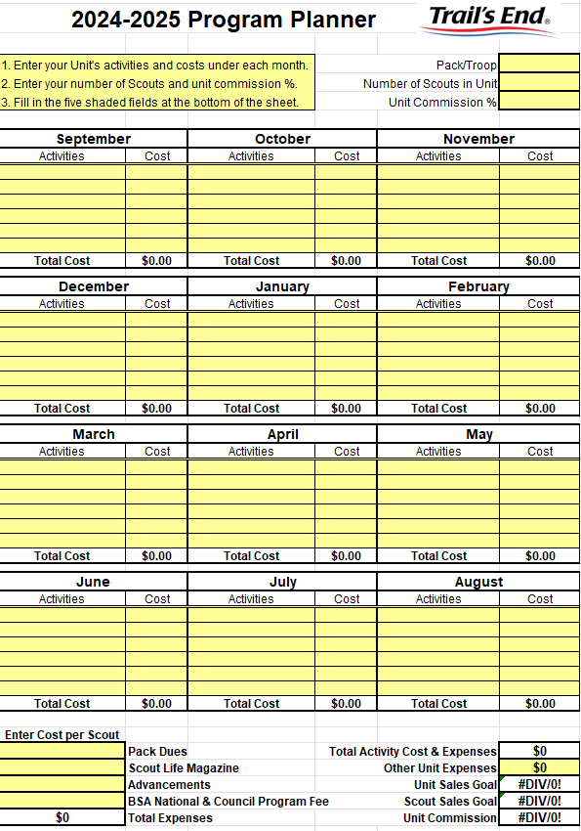
Ideal Year of Scouting
Scout Fundraising
Available for download in training section of the Unit Portal!
Notes:
Include family planner (from IYOS scope sheet)

Slide 7


Ideal Year of Scouting
Scout Fundraising
Help Units (or Scouts) Set Their Budget!
Total Program Costs Unit Commission Sales Goal
Hit Sales Goal 100% PROGRAM FUNDED
Notes:
Include family planner (from IYOS scope sheet)

Slide 8
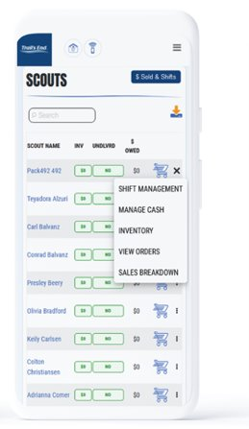
Leader Portal
Scout Fundraising
Your one-stop-shop for sale management!
Order Popcorn
Invite their Scouts to register; manage Scout roster.
Easily set Unit and Scout goals.
View real time reporting of sales, inventory and cash management; all in one place.
Unit-to-Unit product transfers. No Council intervention needed.
Create, schedule, and manage storefront sites and shifts.

Slide 9
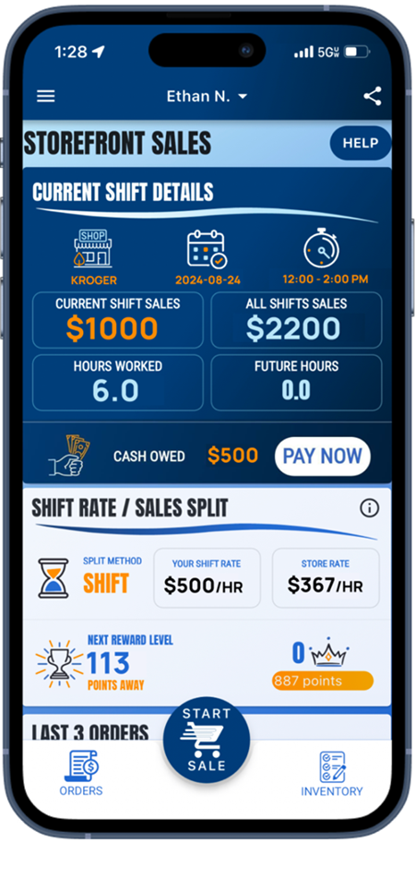
Header
Trail’s End App
Scout Fundraising
Save Time Managing Your Sale!
The App for Scouts to…
track and report real-time storefront, wagon and online sales
accept cash and credit cards
track inventory by Scout and storefront
schedule Scouts for storefronts.
Free Credit Card Processing
Powered by Square | Paid by Trail’s End
Available in Apple and Google Play Stores
New Scouts
Use Unit’s Trail’s End Code or their zip code to register.
Families can use one email for multiple accounts.
Returning Scouts
Sign in using 2023 username
Families: click name dropdown at top of screen to switch between accounts in the App

Slide 10
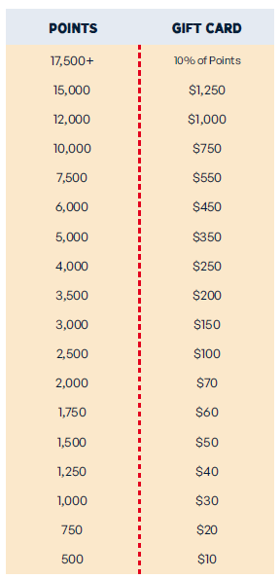
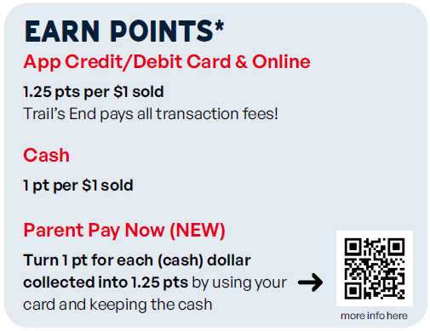

Scouts accumulate points towards Amazon eGift Cards when recording sales in the Trail’s End App.
Scout
Rewards
Bonuses
Sell $500/hour per Scout for any 2 hour storefront shift or longer (July 1 – Dec 15) and earn 0.5 bonus points per $1 sold. To qualify, Unit must select – One Scout per shift split method.
Sell $250+ online (July 1 – Aug 31) and earn 100 bonus points.
Scout Fundraising
Notes:
Make point values BIGGER; Parent Pay Now

Slide 11

How it Works
Storefront
Program
TE is booking the best times at premium locations.
We integrate and plan with data on storefront sales. With TE popcorn, but also based on merchandise being sold inside the store as well as foot traffic.
Our goal is to provide locations that will generate 1 sale every 3 minutes.

Slide 12
Storefront Claiming
Storefront
Program
Saturday, July 20: $20k + Units, 4 reservation blocks​
Sunday, July 21: $15k+ Units, 3 reservation blocks​
Monday, July 22: $10k+ Units, 2 reservation blocks​
Tuesday July 23: All Units, unlimited reservation blocks.

Slide 13
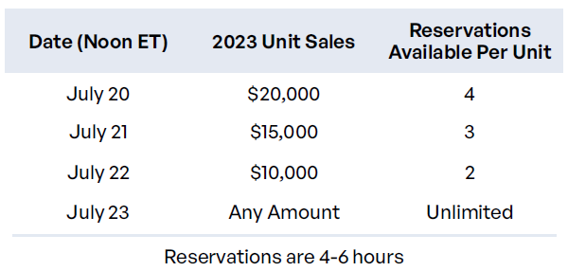
Storefront Settings & Reservations
Header
Scout Fundraising
The BEST SPLIT method for highest sales per hour is One Scout / One Parent
Default Settings
Before reserving, set your split method.
One Scout and their Parent is the BEST split!
Scouts credited for each sale recorded.
Safest and sales won’t go down with splits.
Scouts sell $244 more than other splits.
Units raise $50 more per hour per Scout.
Best practice: 2-hour shifts.
Reservations
Trail’s End is reserving the best selling times and storefronts for your Scout families!
Reserve on Storefront Reservations page
Best hours will be highlighted
Notes:
One Scout and their Parents

Slide 14
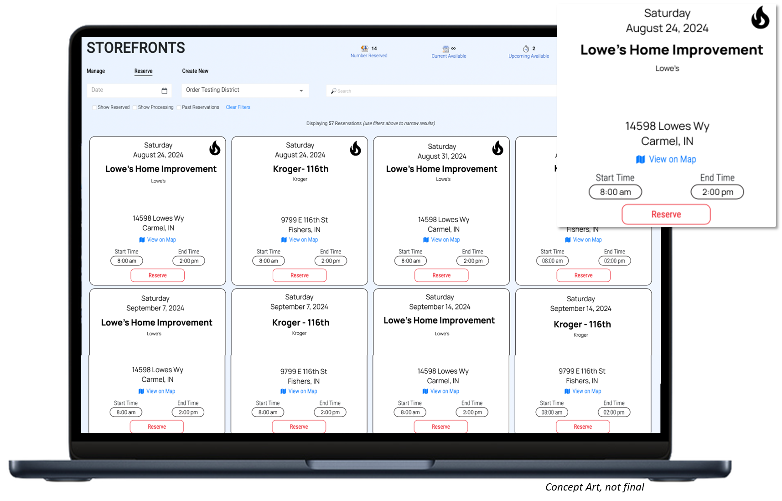
Storefront
Program

Slide 15



Header
Leader Training
Scout Fundraising
Videos
Leader Portal - Training page
Returning Leaders
What’s New?
New Leaders
Ideal Year of Scouting
Unit Kickoff & Parent Buy-In
Leader Portal training
Storefront Best Practices
Storefront Reservations & Management
Managing Inventory
Sale Resources
Leader Portal - Training page
Leader Guide
Unit Program Planner
Scout & Parent Guide
Banner
Table Payments Sign
Scout Pitch
Q&A Webinars
Please watch the training videos before
Trail’s End experts will stay on and answer every question!

Slide 16
sell
sell
sold; selling
transitive verb
to give up (property) to another for something of value (such as money)

Slide 17


Ways to Sell
Scout Fundraising
Storefronts
Setup tables at high foot traffic locations.
Scouts sell to customers coming in and out of stores.
Best Practice: One Scout and their parent per shift.
Wagon
Sell door-to-door
Best Practice: Bring product with you to avoid second trip to deliver.
Scouts can record undelivered orders in App.
Online
Sell virtually to family and friends by sharing your online fundraising page via social, email & text.
Product ships to the customer.
Safest way to sell!

Slide 18
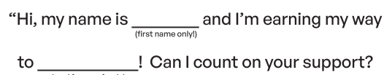
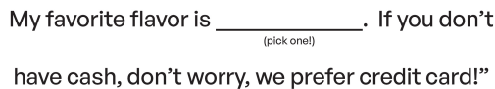
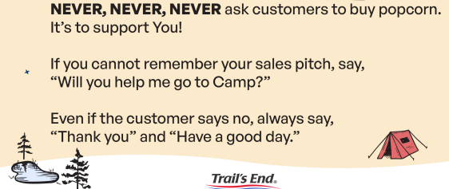
Scout Sales Pitch
Scout Fundraising

Slide 19
Header
Storefront Best Practices
Scout Fundraising
Prep
Enough popcorn to sell $500 per hour.
A fully charged phone with the Trail’s End App.
Bluetooth Square reader
6-foot table and banner
Cash box with small bills to make change.
Scout should use the restroom before shift.
Place products highest to lowest
NEVER put prices on the table.
Scout Role
Wear your uniform.
Stand in front of the table.
Smile and walk up to every person.
Look the customer in the eye and give your pitch.
Guide them to the table to pick their products.
It helps to memorize the prices!
Let your parent handle the money so you can get more customers.
Parent Role
Encourage your Scout to keep asking. “No’s” happen, that’s okay!
Handle table and products setup.
Stand and thank every person!
Share what your Scout will get with the consumers’ support.
Enter orders so your Scout can get more customers.
Submit all donations in the App.
Notes:
Parent Pay Now & Heroes & Helpers

Slide 20






Header
Credit Card
Scout Fundraising
Credit is Best for Scouts
Trail’s End pays all fees!
Square Bluetooth accepts contactless cards, chip cards,
Square Swipers: Lighting (Apple) & Headphone jack (Android)
Manual Entry (no reader): type in card information
Apple Pay, Google Pay & Cash App Pay: use share feature at checkout for customers to pay on their device!
^{NEW}
^{NEW}
Parent Pay Now
Parents use their card and keep the cash.
Storefronts & Wagon
Available at end of shift (more details to come)
Scouts earn more Rewards.
Leader Pay Now
Leaders use their card and keep the cash.
Storefront enabled
Scouts earn more Rewards.
^{NEW}

Slide 21







Product Mix

Slide 22











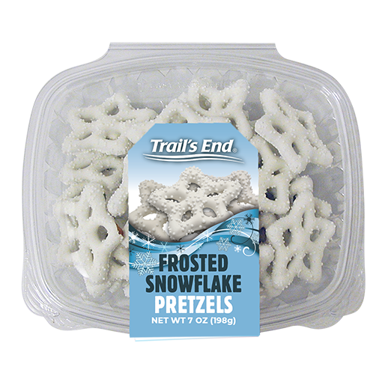
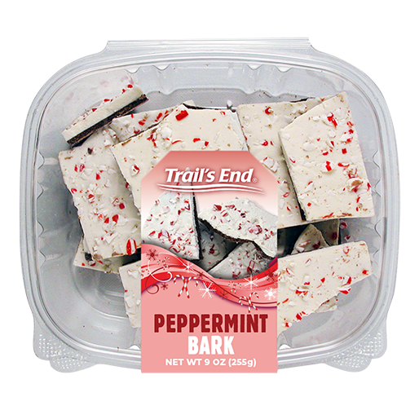
Online Products

Slide 23
Header
Online Best Practices
Scout Fundraising
Safe & Easy
Trail’s End ships the product directly to the customer.
No handling of products or cash for Scouts or Unit.
As many traditional products and prices as possible.
Additional products available online.
Customize Page
Create a description with why you’re fundraising and what you’re planning for the year.
Select your favorite product.
Make the bio page your own!
Share
Share on social media platforms and send to family and friends
Create a fun special text or video to make your ask personal
Encourage Scouts and parents to share throughout the campaign, Online is year-round!
Notes:
Parent Pay Now & Heroes & Helpers

Slide 24

Donations
Scout Fundraising
^{NEW}
Heroes & Helpers Donations
Donations in App will be automatically processed nightly & reflected on Unit orders, eliminating manual ordering, and saving time!
Products and flavors consumers purchase every day.
Fewer products simplifies the sale for Councils, Units & Scouts.

Slide 25

wrap up
wrap·up
wrapped up; wrapping up; wraps up
transitive verb
to bring to a usually successful conclusion

Slide 26
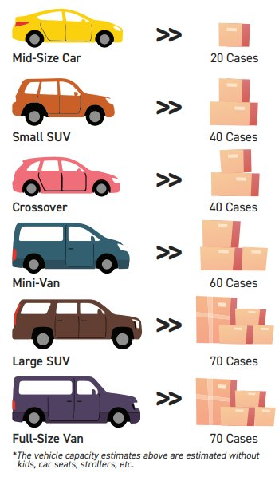
Header
Council Key Dates
Scout Fundraising
Show & Sell Orders Due: 7/25/2024
Show & Sell Distribution: 8/9/2024
- at ATAS International: 6642 Grant Way Allentown PA 18106
Show & Sell Returns: 11/4/24-11/6/24
-at Minsi Trails Council Office 10:00am-5:00pm
Show & Sell Payments: 11/6/2024
Take Orders Due: 11/7/2024
Take Order Distribution: 11/22/2024
Final Payment Due: 12/9/2024

Slide 27






Header
Council Commissions / Incentives
Scout Fundraising
TOTAL COMMISSION POSSIBLE =
38%

Slide 28



Support
Scout Fundraising
Council Support
Brennan Malenovitch-
610-465-8560
Brennan.Malenovitch@scouting.org
Teresa Smith-
610-465-8574
Teresa.smith@scouting.org
Trail’s End Support
Visit our FAQ page for answers to commonly asked questions & to open a ticket.
REGISTER NOW
Facebook Group
Join Trail’s End Popcorn Community for best practices, support, news, and answers to questions.

Slide 29

2023
REGISTER NOW

